Slide 1
JAVA PROJECT
ROOFTOP SOLAR
ENERGY MONITOR
Monitor • Calculate • Classify • Analyze
TEAM MEMBERS
K. Shanmuk — 2620040047
K. Sai Varshith Krishna — 2620040129
D. Sri Pavan Ranga — 2620040106
01

Slide 2
PROJECT OVERVIEW
02
Abstract
What the application does
SOLAR ENERGY FLOW
• Accepts voltage and current for multiple solar panels.
• Calculates generated power using Power = Voltage × Current.
• Classifies each panel as NORMAL, MODERATE, or LOW POWER.
• Calculates total and average power.
• Performs searching, sorting, and 2D-array monitoring.
V
VOLTAGE
A
CURRENT
W
POWER
OK
STATUS
NORMAL ≥ 500 W | MODERATE 300–499.99 W | LOW < 300 W

Slide 3
PROJECT LOGIC
03
Understanding Problem Statement
01
02
03
04
05
INPUT
CALCULATE
CLASSIFY
ANALYZE
REPORT
Panels
Voltage
Current
Power = V × I
Normal
Moderate
Low
Total
Average
Search
Ranking
2D data
Problem
Solar panels can produce different amounts of power. Manual calculation and comparison becomes inconvenient when multiple panels are involved.
Output → individual power • status • total • average • search result • ranking • monitoring data

Slide 4
JAVA SYLLABUS
04
CO-1 — Fundamentals
INPUT
PROCESS
OUTPUT
Voltage (V)
Current (A)
Number of panels
User input via Scanner
Power = Voltage × Current
Variables & data types
Arithmetic operators
Relational operators
Panel power
Panel status
Total power
Average power
Concepts demonstrated
Computational Thinking • IPO Model • Problem Solving • Java Program Structure • int / double • Operators • Scanner

Slide 5
JAVA SYLLABUS
05
CO-2 — Control & Iteration
PANEL STATUS LOGIC
DECISIONS
ITERATION
if
else-if
else
for loop
Repeated processing
if (power[i] >= 500)
NORMAL
else if (power[i] >= 300)
MODERATE
else
LOW POWER
METHODS
INTEGRATION
Total power
Linear search
Sorting
Input → Process
→ Decision → Report
for loop → processes every panel
Overall system decision: average power is used to determine whether the system is NORMAL or NEEDS ATTENTION.

Slide 6
JAVA SYLLABUS
06
CO-3 — Arrays & Data Processing
1D ARRAYS
LINEAR SEARCH
BUBBLE SORT
V
I
P
P
Find a requested power value in the panel data.
Arrange power values from highest to lowest.
Voltage • Current • Power
2D ARRAY
PROCESSING
Morning + Evening monitoring data.
Row-wise / column-wise traversal.
INTEGRATED APPLICATION
Arrays + Searching + Sorting
+ 2D Arrays + Iteration
+ Data Processing

Slide 7
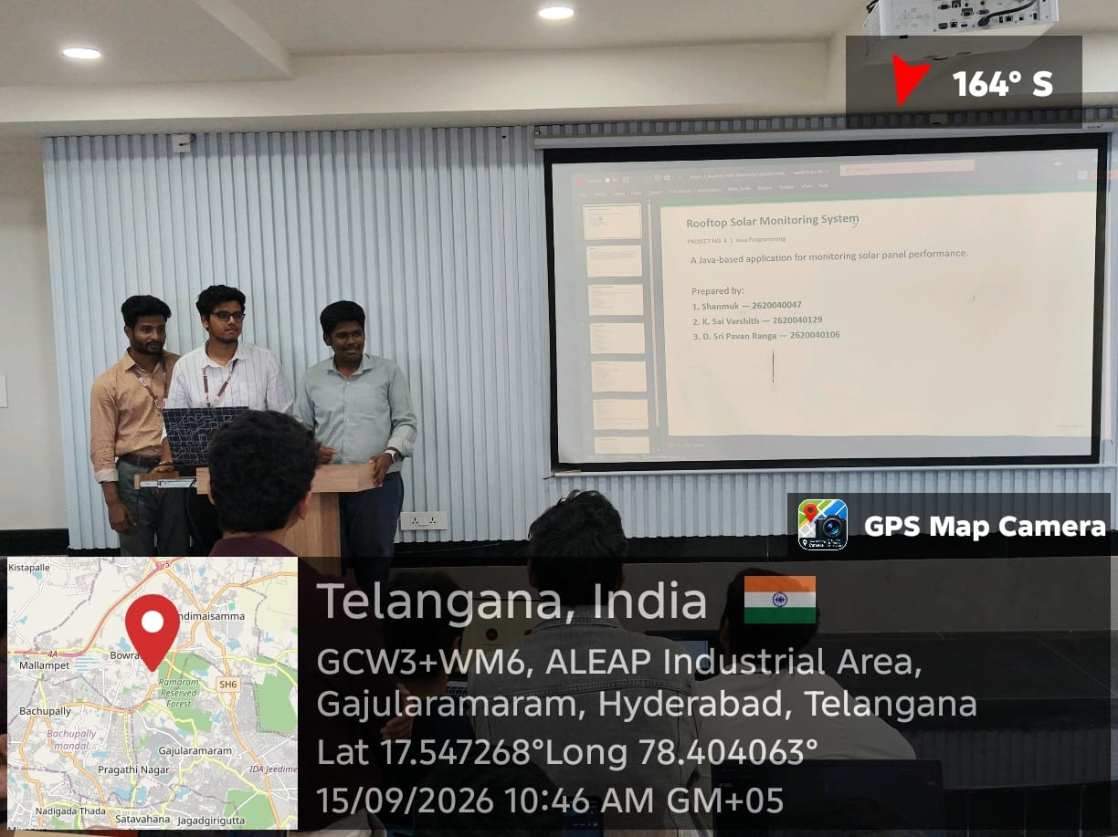
PROJECT SUBMISSION
07
Geo-Tag Photo & GitHub
GITHUB REPOSITORY
https://github.com/kandoorishanmukharigupta-jpg/KLH-PSPJ-S16-TEAM-NO.4/blob/main/Rooftop_Solar_Energy_Monitor_Fresh_Design%20(2).pptx
Use the actual geo-tagged photo required by your college.
ROOFTOP SOLAR ENERGY MONITOR

